Slide 1

From Cognitive Assessments to lifestyle data: A predictive Model for Alzheimer’s Disease onset
By
Suhani Yalaga
Saketha kusu

Slide 2
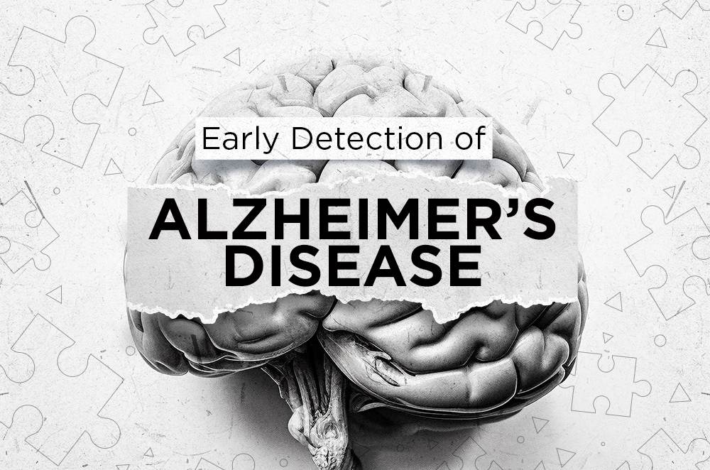
Project Overview
Title: Alzheimer’s Disease Detection Using Machine Learning Goal: Build ML models to predict Alzheimer’s diagnosis based on lifestyle and clinical data.
Methods:
Data preprocessing
Feature selection (RFE)
Class balancing (SMOTE)
Training models- logistic regression, SVM, Random forest
Hyperparameter tuning- GridsearchCV
Model performance

Slide 3

Introduction
Alzheimer’s Disease (AD) is a progressive neurodegenerative disorder that affects memory and cognitive function.
In the U.S., 6.9 million people aged 65+ live with AD expected to double by 2050 (Alzheimer’s Association, 2024).
Early diagnosis is critical for timely intervention and better management of the disease.
This project aims to build an accurate ML-based predictive model for early Alzheimer’s detection.
The model uses cognitive assessments, lifestyle factors, and medical history as input features.
It helps identify individuals at risk, supporting early intervention and personalized treatment.
Results will offer insights into key risk factors and aid healthcare professionals in data-driven decision-making.

Slide 4

Data Set Overview
Source: Kaggle
Size: 2,149 records, 35 features
Target column: Diagnosis (0 = No Alzheimer’s, 1 = Alzheimer’s)
Contains clinical data (MMSE, cholesterol, BMI) and lifestyle factors (Smoking, Diet, Alcohol)etc.
Features Included:
Demographics: Age, Gender, Ethnicity, Education Level
Lifestyle: BMI, Smoking, Alcohol Consumption, Physical Activity, Diet Quality, Sleep Quality
Medical History: Family History of Alzheimer's, Cardiovascular Disease, Diabetes, Depression, Head Injury, Hypertension
Clinical Measurements: Systolic BP, Diastolic BP, Cholesterol (Total, LDL, HDL, Triglycerides)
Cognitive Assessments: MMSE, Functional Assessment, Memory Complaints, Behavioural Problems, ADL
Symptoms: Confusion, Disorientation, Personality Changes, Difficulty Completing Tasks, Forgetfulness.

Slide 5
Literature Review – Recent Advances in AI-driven CDSS & Alzheimer’s Risk Factors
Area of Advancement | Key Insights
Multimodal AI Models for Early Prediction | Combines MRI, PET scans & clinical data for higher accuracy - Deep learning (CNNs, Transformers) achieve >85% accuracy - Standardization challenges
Oral Health & Alzheimer's Risk | Gum disease bacteria linked to Alzheimer’s plaque buildup - Inflammation caused by P. gingivalis may trigger neurodegenerative processes
Predictive Biomarkers & Personalized Risk | AI predicts AD up to 7 years early with ~72% accuracy - Key predictors: amyloid-beta, tau, APOE-ε4 - Higher risk in women
Integration into Clinical Workflows | AI embedded into EHRs for real-time CDSS - Scotland project analyzing 1.6M brain scans - Eye scans used for non-invasive early screening
Explainable AI for Clinical Adoption | Black-box models limit clinical trust - SHAP, LIME, Swap Test improve interpretability - EBMs highlight feature importance

Slide 6

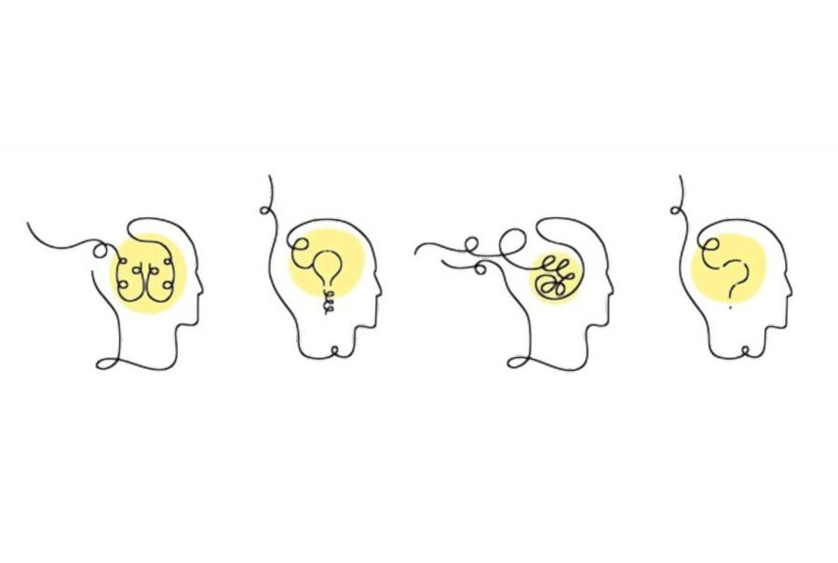
Data Preprocessing
1. Imported necessary libraries and loaded the dataset
2. Handled Missing Values
Checked for missing values across all columns.
For numerical features: filled missing values with the mean.
For categorical features: filled missing values with the mode (most frequent value).
3. Removed Duplicates
Removed duplicate rows to ensure data quality.
4. Applied label encoding on all categorical features except the target variable diagnosis.

Slide 7
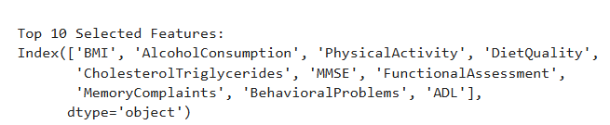
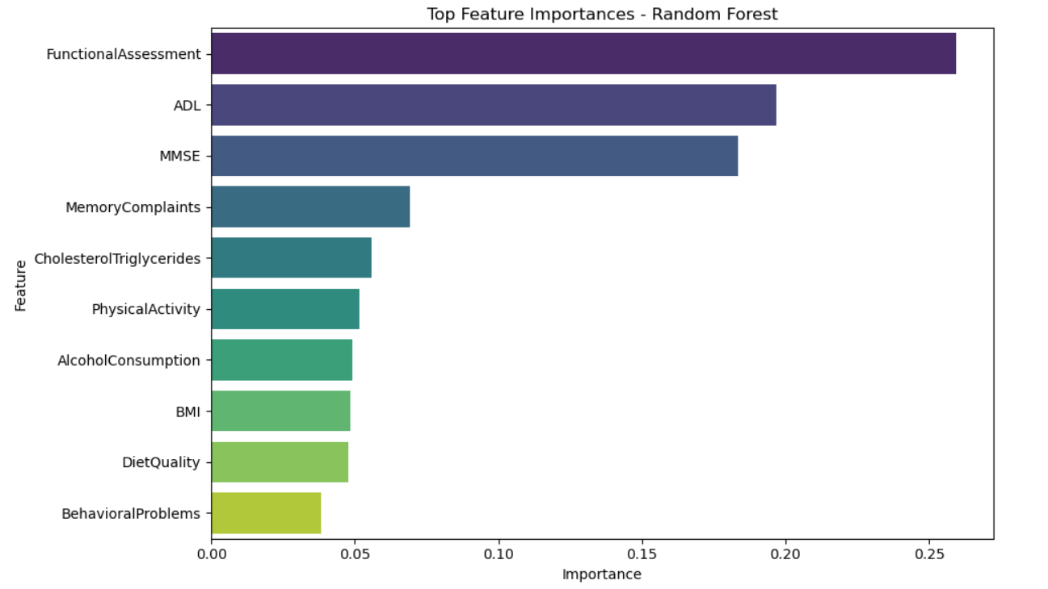
Feature scaling & Feature selection using RFE
Feature scaling:
Dropped non-informative columns like patientID, doctorincharge
Used Standardscaler to normalize all remaining features to a standard normal distribution.
Feature selection:
Used Recursive Feature Elimination (RFE) with a random forest classifier to selected the top 10 most important features for the prediction task.

Slide 8
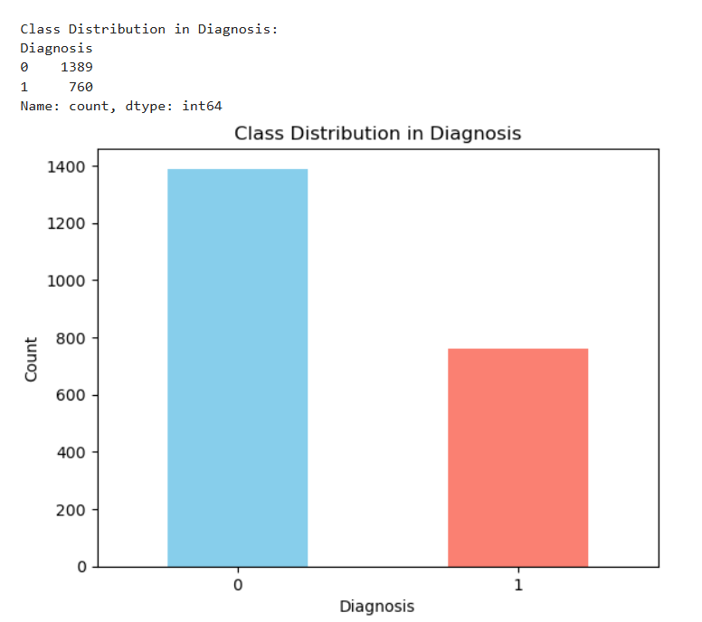
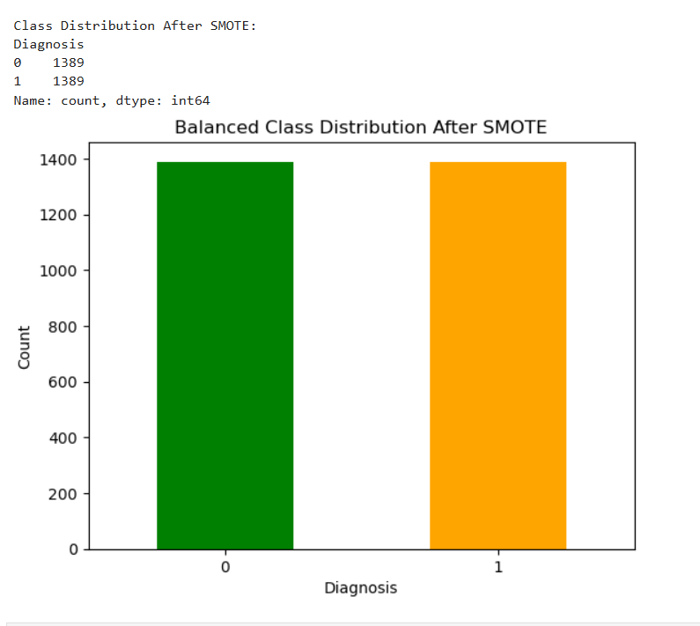
Class imbalance handling
The original data set showed a significant class imbalance
Non-Alzheimer’s (0): 1,389 cases
Alzheimer’s (1): 760 cases
This imbalance can bias the model to favour the majority class.
To resolve this we applied SMOTE ( Synthetic Minority Over-sampling Technique):
SMOTE generates synthetic samples for minority class (1)
After SMOTE both classes were equalized
Benefits of balancing – prevents model from overfitting to majority class
Improves recall and F1 score for alzeimer’s class
Ensure fair evaluation and generalization

Slide 9
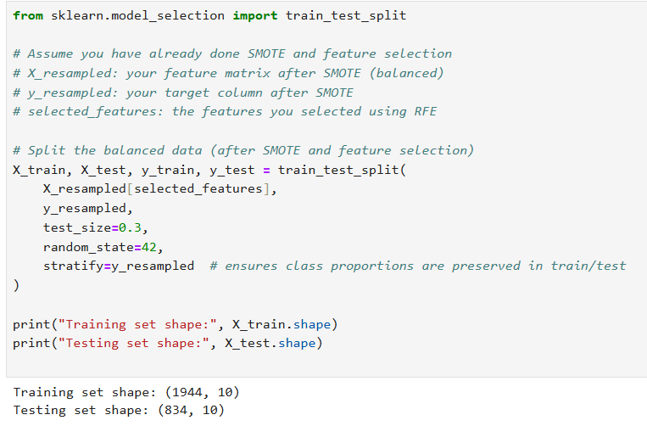
Model training & evaluation
Train-Test split
Used train_test_split() from skleran
70% for training
30% for testing
Stratify=y to preserve class distribution in both sets.
Avoid data leakage and tests performance on unseen data.
We trained e supervised learning models on the balanced dataset using the top 10 features selected via RFE .
All models were evaluated using accuracy, precision, recall and F1- score on the test set.

Slide 10
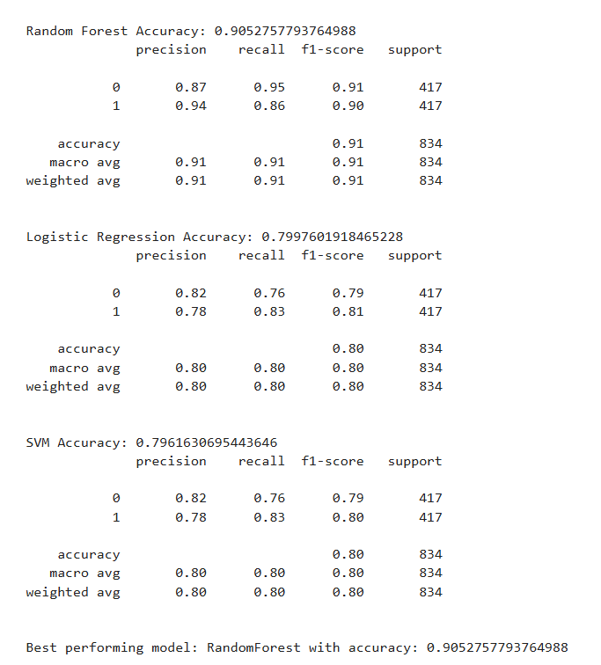
Classification report
Random Forest achieved the highest accuracy (0.91) with balanced precision and recall for both classes.
It showed strong performance in detecting Alzheimer’s cases (1):
Precision: 0.94, Recall: 0.86, F1-score: 0.90
Other models (Logistic Regression and SVM) performed reasonably but lagged behind in precision and recall.
Final model selected: Random Forest due to its strong classification and generalization performance

Slide 11
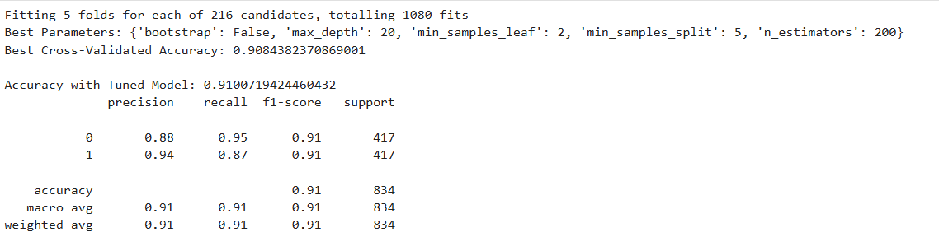
Hyperparameter tuning: GridsearchCV
To further improve model performance, we used GridSearchCV to tune the hyperparameters of the Random Forest model.
Total combinations tested: 216
Cross-validation folds: 5
Total model fits: 1,080
Best Parameters found.
Why Tuning Helped:
Improved performance slightly from default RF model (0.905 → 0.910).
Helped control overfitting and underfitting
Ensured the final model generalizes well to new, unseen patient data.

Slide 12
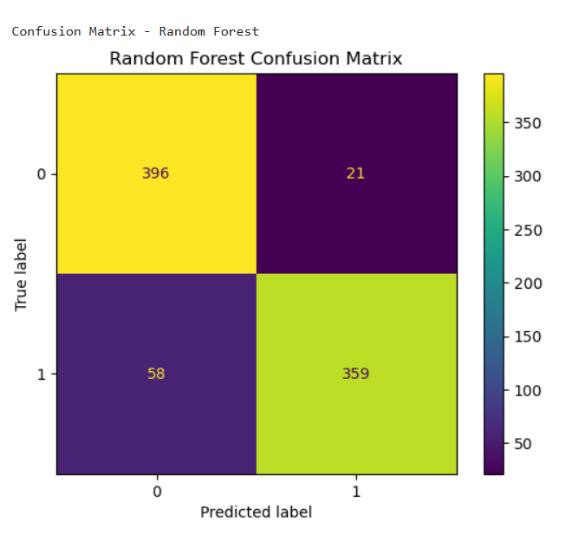
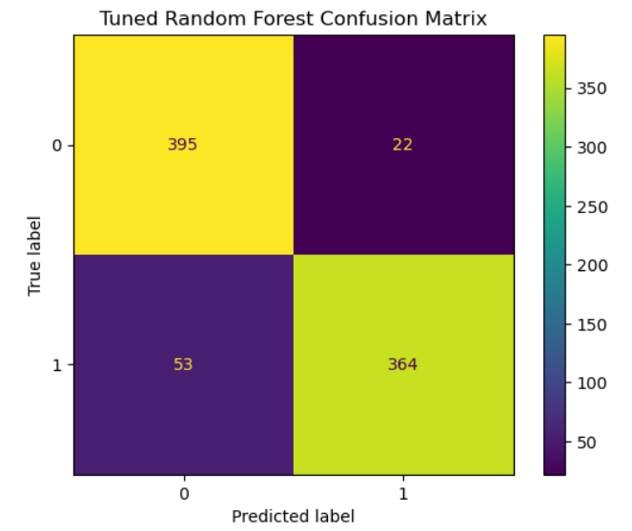

Slide 13

Patient prediction test
To test the real-world performance of our final model, we created a synthetic patient case using sample values from the selected top 10 features.
The predicted probabilities show that the model is not just guessing, it understands the underlying pattern in the data and assigns strong confidence to its predictions.
The model confidently classified the patient as non-demented with 90% certainty.
Prevents unnecessary anxiety or testing, if the probability was borderline 55%/45% doctors could flag the patient for monitoring.
Shows that our model is not just accurate on average its also reliable in individual predictions.

Slide 14
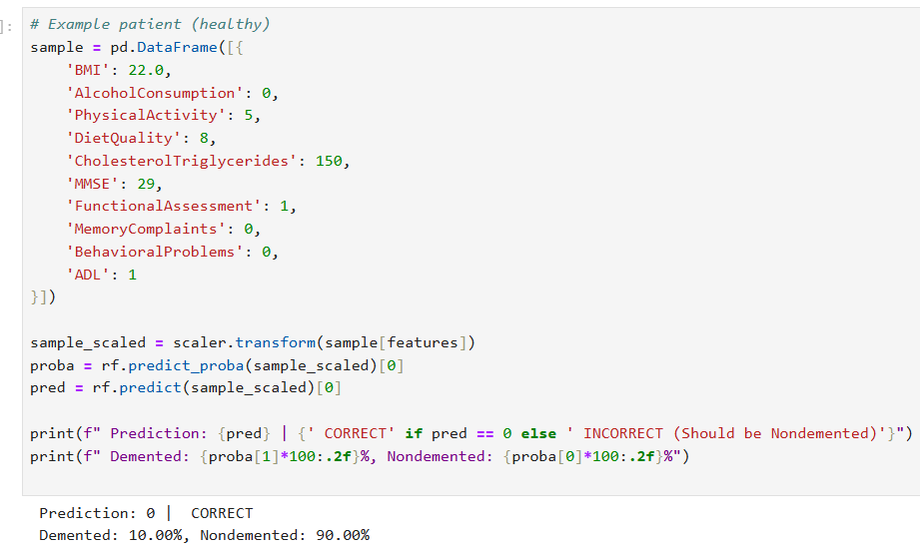

Slide 15

Future work development
Add more diverse data (MRI scans, genetics, clinical history)
Use time-series models to track disease progression
Explore deep learning (CNNs, LSTM, etc.) for enhanced performance
Develop a web-based clinical decision support tool
Apply NLP to analyze doctor notes and patient history
Use SHAP/LIME for model interpretability
Test and validate the model on real-world patient data

Slide 16

2024 Alzheimer’s disease facts and figures. (2024). Alzheimer S & Dementia, 20(5), 3708–3821. https://doi.org/10.1002/alz.13809
News-Medical. (2024, September 4). Alzheimer’s disease: $14.5 trillion burden on global economy by 2050. https://www.news-medical.net/news/20240904/Alzheimers-disease-24145-trillion-burden-on-global-economy-by-2050.aspx
3. Livingston, G., Huntley, J., Sommerlad, A., Ames, D., Ballard, C., Banerjee, S., ... & Mukadam, N. (2020). Dementia prevention, intervention, and care: 2020 report of the Lancet Commission. The Lancet, 396(10248), 413-446. https://doi.org/10.1016/S0140 6736(20)30367-6.
4. Jack, C. R., Bennett, NIA-AA Research Framework: Toward a biological definition of Alzheimer's & Dementia, 14(4), 535-562. https://doi.org/10.1016/j.jalz.2018.02.018.

Slide 17


